Slide 1
Processor Architecture: RISC-V

Slide 2
RISC-V (pronounced “risk-five”)
A new instruction-set architecture (ISA)
originally designed to support computer architecture research and education
But now hope will also become a standard free and open architecture for industry implementations.
A completely open ISA that is freely available to academia and industry.
A real ISA suitable for direct native hardware implementation, not just simulation or binary translation.
Origin: Started as a “3-month project” in 2010 at UC Berkeley

Slide 3
What is RISC-V?
A high-quality, license-free, royalty-free RISC ISA
Standard maintained by the non-profit RISC-V Foundation
Suitable for all types of computing systems
From Microcontrollers to Supercomputers
RISC-V is available freely under a permissive license
RISC-V is not…
A Company
A CPU implementation
Many versions
RV32I/64I - most basic 32/64-bit implementation

Slide 4
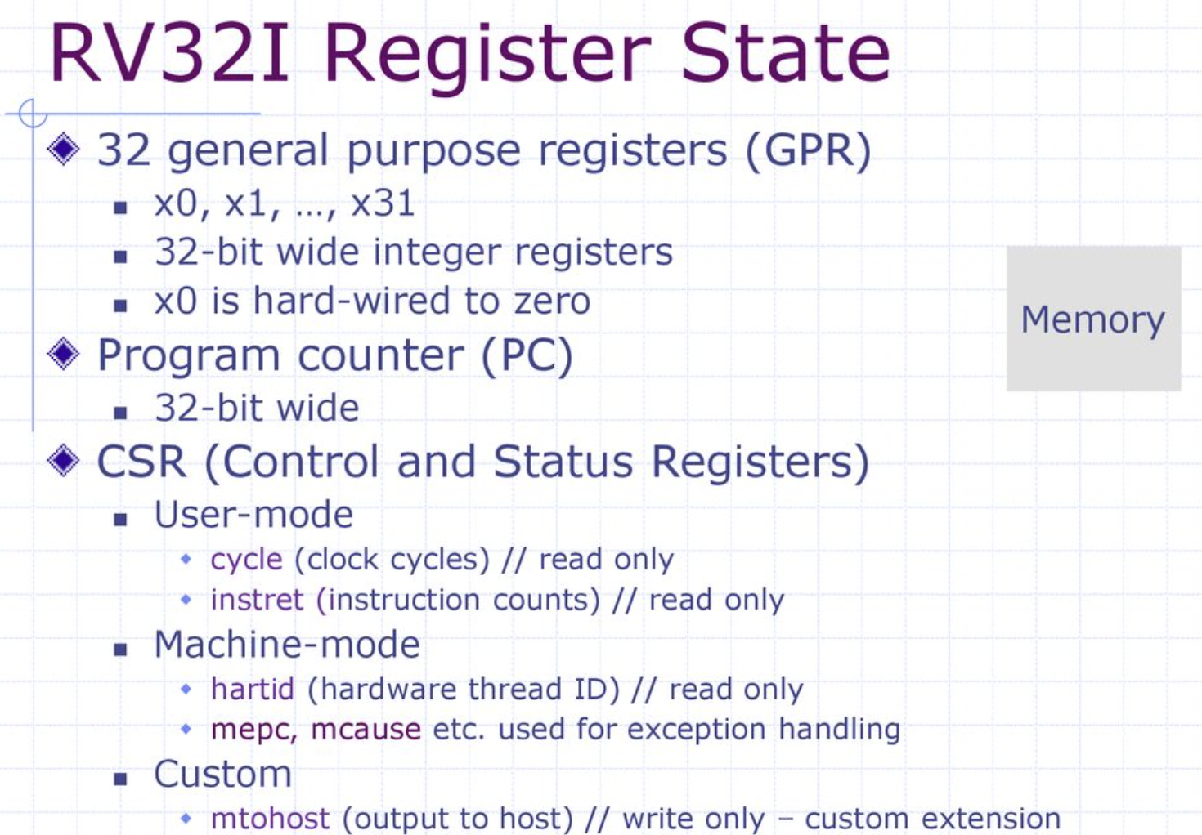

Slide 5
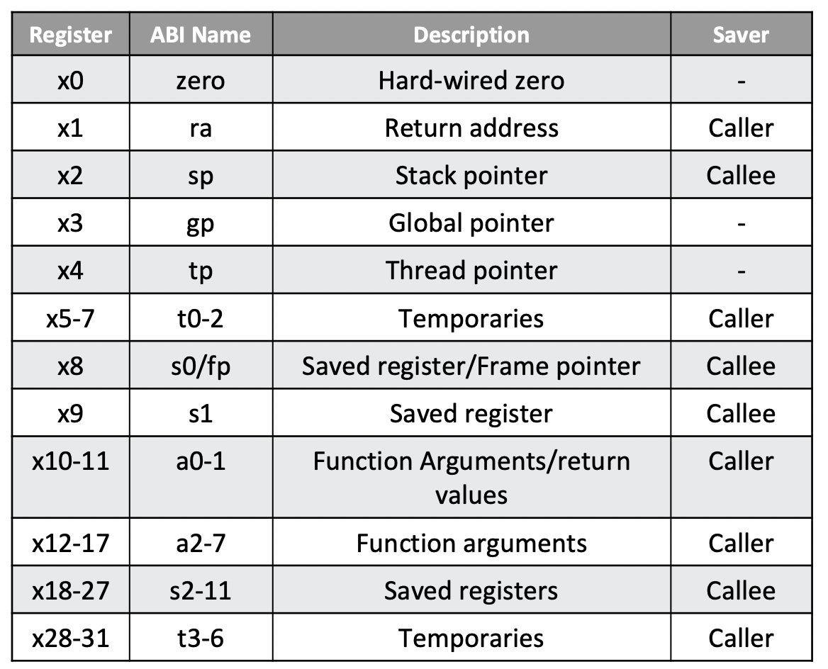
RV32I - GPR registers

Slide 6
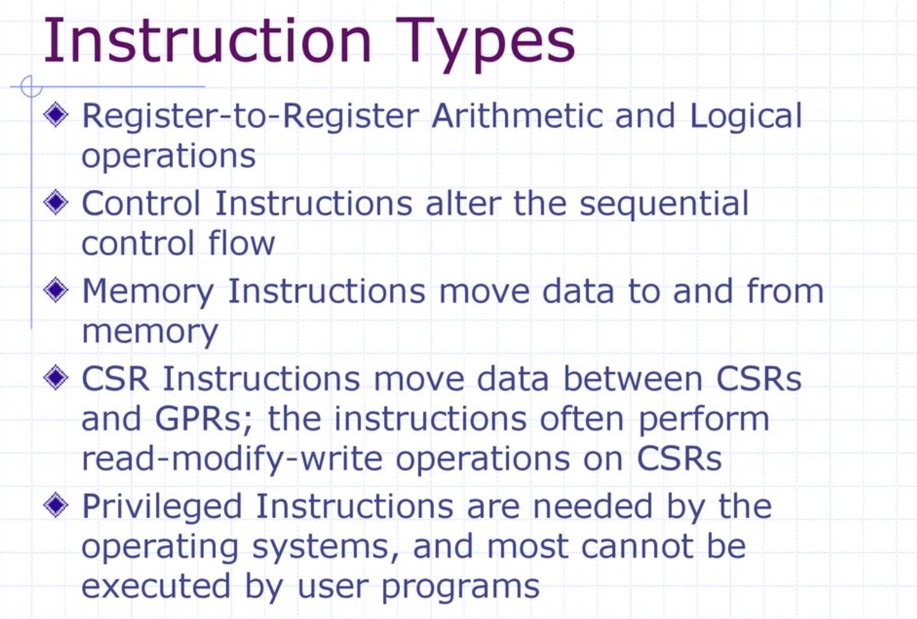

Slide 7
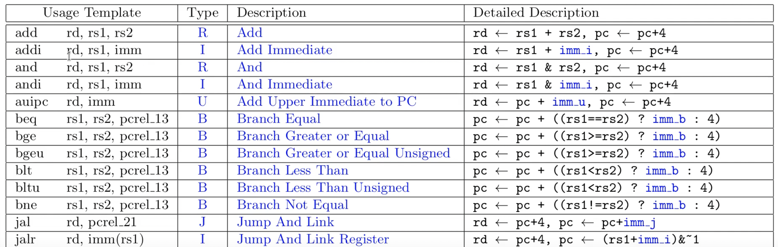
RISC-V instruction format

Slide 8
RISC-V specification (RTFM)
https://riscv.org/wp-content/uploads/2019/12/riscv-spec-20191213.pdf
Introduction to RISC-V and the RV32I Instructions
https://www.youtube.com/watch?v=LKB5I12LctU
C to RISC-V assembly
https://www.youtube.com/watch?v=XVU_RNiz09A

